Slide 1

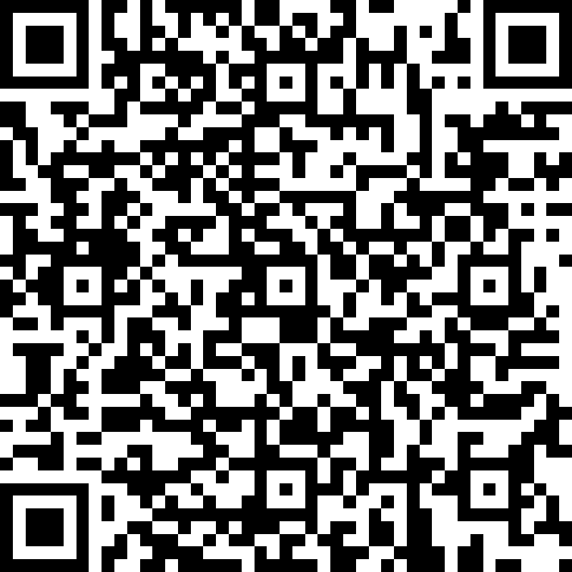
Microsoft Entra ID Governance POC Feedback
https://aka.ms/IGAPOCSurvey

Slide 2
Microsoft Entra ID Governance
Govern guest and partner access to resources
Proof of concept – Pre-work Call
<<Subtitle or speaker name>>

Slide 3
Proof of concept (PoC) | Goals
Govern guest and partner access to resources
Demonstrate the value of Microsoft Entra ID Governance in your environment:
Discovery: Identify current lifecycle and governance processes for external identities to determine applicable scenarios, feasibility and scope.
How is the onboarding process for external identities?
Is there any process to remove unused external identities?
Define: On a successful completed lifecycle for pilot external identities.
Evaluate: the result of the POC by collecting customer feedback and team insights

Slide 4
Scenario’s Key Requirements
Make sure you meet these requirements to avoid any roadblocks
Microsoft Entra ID P1 or P2 license
Microsoft Entra ID Governance SKU (Logic Apps and Auto Assignment Policies) - How to start a Microsoft Entra ID Governance Trial)
2 Azure Active Directory Tenants
A cloud user account on the target tenant to approve and access
A cloud user on the Source tenant to request Access
Account with User administrator, Identity Governance Administrator, Privileged Role Administrator or Global administrator on the target tenant

Slide 5
PoC Stakeholders
Common customer stakeholders
We will engage the following stakeholders at specific stages of the POC:
Identity team: Microsoft Entra ID Global Administrator
Azure logic app contributor (or similar)
Security Admin
Development Teams (Graph API, Custom workflows)
Microsoft stakeholder
PoC driver: Microsoft engineer who will guide you during the PoC process

Slide 6
PoC | Timeline
Delivery stages
Onboarding and Discovery
Auto assign Resources
Custom Workflows
Convert existing External Users
Access Recertification
Close-out
2 hours
1 hour
2 hours
1 hour
1 hour
1 hour
8 hours
Logistics
Each stage will only require participation of a subset of stakeholders from customer
Times are estimated based on scenario complexity

Slide 7
PoC | Phase 1: Onboarding and Discovery
Onboarding and Discovery
Auto assign Resources
Custom Extensions
Convert existing External Users
Access Recertification
Close-out
2 hours
1 hour
2 hours
1 hour
1 hour
1 hour
Session (2 hour): Onboarding and discovery
Who? → All teams
Working session
2 hours, depending on complexity of scenario
Role | Responsibility
Identity Governance Administrator | →Configure connected Organization and Access Package
Security Admin | →Ensure solution meets organizational security policies
Compliance Manager | → Ensure solutions complies with regulations

Slide 8
PoC | Phase 2: Auto assign resources
Onboarding and Discovery
Auto assign Resources
Custom Extensions
Convert existing External Users
Access Recertification
Close-out
2 hours
1 hour
2 hours
1 hour
1 hour
1 hour
Session (1 hour): Auto assign resources
Who? → All teams
Working session
1 hour, depending on complexity of scenario
Role | Responsibility
Identity Governance Administrator | →Configure Access Package
Security Admin | →Ensure solution meets organizational security policies
Compliance Manager | → Ensure solutions complies with regulations

Slide 9
PoC | Phase 3: Custom Workflows
Onboarding and Discovery
Auto assign Resources
Custom Extensions
Convert existing External Users
Access Recertification
Close-out
2 hours
1 hour
2 hours
1 hour
1 hour
1 hour
Session (3 hours): Custom workflows
Who? → All teams
Working session
3 hours, depending on complexity of scenario
Role | Responsibility
Identity Governance Administrator | →Configure Access Package
Security Admin | →Ensure solution meets organizational security policies
Compliance Manager | → Ensure solutions complies with regulations
Development Teams | → Assist on build applications like custom workflows

Slide 10
PoC | Phase 4: Convert existing External Users
Onboarding and Discovery
Auto assign Resources
Custom Extensions
Convert existing External Users
Access Recertification
Close-out
2 hours
1 hour
2 hours
1 hour
1 hour
1 hour
Session (1 hour): Convert existing external users
Who? → All teams
Working session
1 hour, depending on complexity of scenario
Role | Responsibility
Identity Governance Administrator | →Configure Access Package
Security Admin | →Ensure solution meets organizational security policies
Compliance Manager | → Ensure solutions complies with regulations
Development Teams | → Assist on build applications like custom workflows

Slide 11
PoC | Phase 5: Access Recertification
Onboarding and Discovery
Auto assign Resources
Custom Extensions
Convert existing External Users
Access Recertification
Close-out
2 hours
1 hour
2 hours
1 hour
1 hour
1 hour
Session (1 hour): Access recertification
Who? → All teams
Working session
1 hour, depending on complexity of scenario
Role | Responsibility
Identity Governance Administrator | →Configure Access Package
Security Admin | →Ensure solution meets organizational security policies
Compliance Manager | → Ensure solutions complies with regulations

Slide 12
PoC | Phase 5: Close-out
Onboarding and Discovery
Auto assign Resources
Custom Extensions
Convert existing External Users
Access Recertification
Close-out
2 hours
1 hour
2 hours
1 hour
1 hour
1 hour
Wrap-up session (1 hour)
Who?
→ All teams
→ Leadership team
Goal
Present POC results
Discuss strategy to further implement
Fill out POC closeout survey

Slide 13
Microsoft Entra ID Governance features used on this scenario
Feature | Description | Stage | Governance SKU
Entitlement Management (EM) | Enables organizations to manage identity and access lifecycle at scale, by automating access request workflows, access assignments, reviews, and expiration. | General Availability | No
EM + Custom Extensions (Logic Apps) | Logic Apps with entitlement management can expand governance workflows beyond the core entitlement management use cases. | General Availability | Yes
EM + Auto assignment policies | Use rules to determine access package assignment based on user properties in Azure Active Directory (Microsoft Entra ID) | General Availability | Yes
EM + Guest Conversion | Convert ungoverned users to be governed | Public Preview | Yes
EM Invite + Assign Any | Allows to directly assign external users to an access package to make collaborating with partners easier. | Public Preview | Yes
AR - Inactive Users | Review and address stale accounts that haven’t been active for a specified period on a regular basis. | General Availability | Yes
AR - Machine learning assisted access certifications and reviews | Provides ML-based recommendations to the reviewers of an access review based on the organization’s reporting structure. | General Availability | Yes
AR - PIM For Groups | Review access for PIM for Groups on a regular basis. | Public preview | Yes
Identity Governance Dashboard | Discovers usage information about various Identity Governance & Administration (IGA) features configured in your tenant. | Public Preview | Yes
Source
Microsoft Entra ID Governance licensing fundamentals
Notes:
The following governance features went GA and are part of the Microsoft Entra ID Governance SKU:
Lifecycle workflows (LCW) – Enables you to use custom workflows to automate identity lifecycle management tasks for your Microsoft Entra ID users by managing your joiner, mover, and leaver lifecycle processes. With LCW, you can leverage Microsoft Entra ID to confidently deploy workflows to configure out-of-the-box actions to onboard and offboard your employees.
LCW + Custom Extensions (Logic Apps) - Lifecycle Workflows can be used to trigger custom tasks via an extension to Azure Logic Apps.

Slide 14
Microsoft Entra ID Governance
Govern guest and partner access to resources
Proof of concept deployment
<<Subtitle or speaker name>>

Slide 15













External identities Overview
Azure AD Accounts
Microsoft Accounts
B2B collaboration invitation
Microsoft Identity
External User (Partner, Vendor, Supplier)
Email One-time passcode
Invitation redemption
or self-service sign-up
B2B collaboration
User object
SAML/WS-Fed
Federation
Your Organization’s Microsoft Entra ID
Social Identities
Notes:
B2B collaboration - Collaborate with external users by letting them use their preferred identity to sign in to your Microsoft applications or other enterprise applications (SaaS apps, custom-developed apps, etc.). B2B collaboration users are represented in your directory, typically as guest users.
Users can either be invited or self-service onboard to your directory.

Slide 16
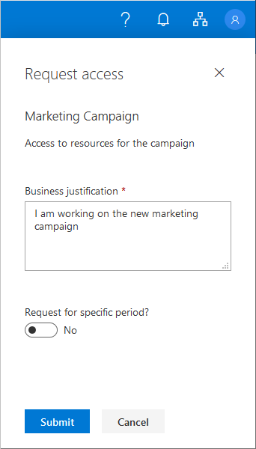
How to Provision guests into Microsoft Entra ID
Users can self service sign-up via Entitlement Management
Notes:
What is entitlement management? - Azure AD | Microsoft Docs

Slide 17
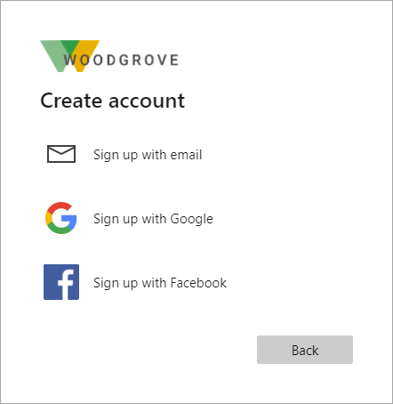
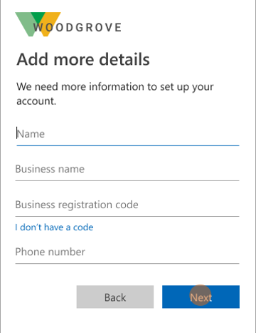
Users can self service sign-up via External Identities User Flows
How to Provision guests into Microsoft Entra ID
Notes:
Self-service sign-up for External Identities - Azure AD | Microsoft Docs

Slide 18
Should I use Entitlement Management or SSSU?
Answer: It depends on what you're looking for.
Entitlement Management
Both
Self Service Sign-up
Requested via MyAccess portal or link
Access Package
Built-in Approval Workflow
Can scope who can request by organization
Lifecycle automated
Supports:
SAML/WS-Fed Identities
Request triggered by end user
Can collect additional attributes
Can trigger custom logic apps/APIs (approval workflows, etc.)
Can be made available to anyone
Supports:
Microsoft Entra ID
Email OTP
Branded onboarding from login page
User can create an account at the app
Flexible localization and language options
Supports:
Google
MSA
Facebook

Slide 19
Onboarding and Discovery

Slide 20
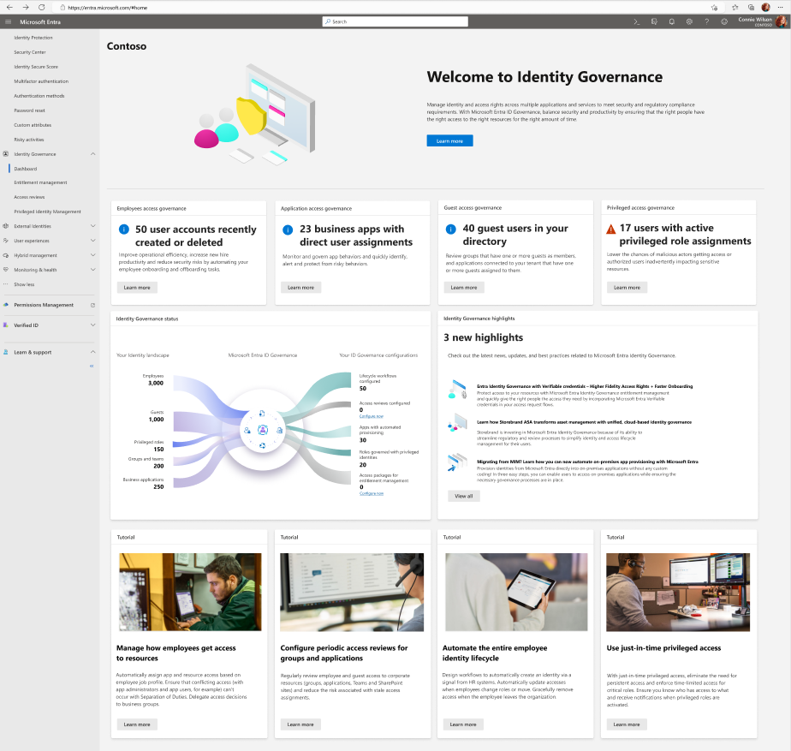
Discover new insights and actions that will improve your ID Governance posture
One page to to track your ID Governance journey
Action oriented activity insights
Assess whether and how you need to respond to potential issues
Intelligent recommendations to optimize your environment
Notes:
A picture speaks 1,000 words: ID Governance dashboard
Visual report of the organization’s identity governance posture

Slide 21
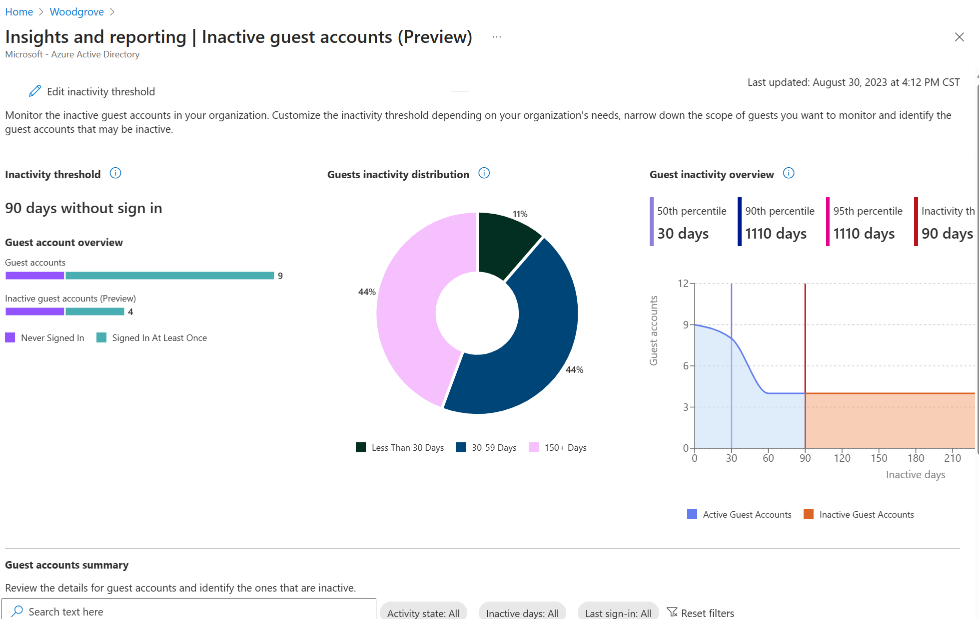
Get Insights on existing External Users

Slide 22
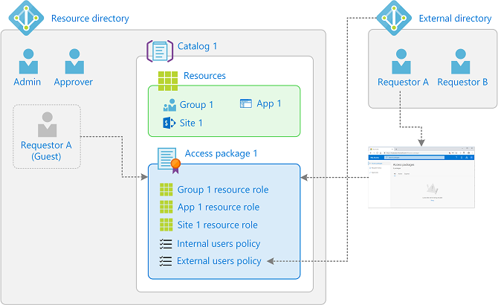
How access works for external users

Slide 23



Guest attribute management
Administrator configures questions
Question: Have you read the NDA?
Attribute: What company are you from?
Collect additional information from requestors
Include custom questions that are surfaced within the request flow.
Approvers are shown the information as part of the request so they can make better decisions.
Requestor provides answers
Have you read the NDA? Yes
What company are you from? Fabrikam
Approver views answers and approves
Have you read the NDA? Yes
What company are you from? Fabrikam
Store provided information in User attributes
If your apps or processes need to reference it later, you can also store requestor information in attributes automatically.
Especially useful for onboarding external users.
Write attribute values to User object
User.Company = Fabrikam

Slide 24

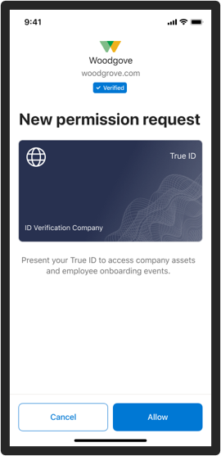
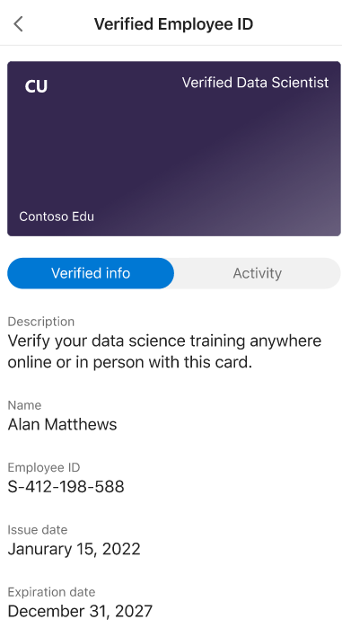
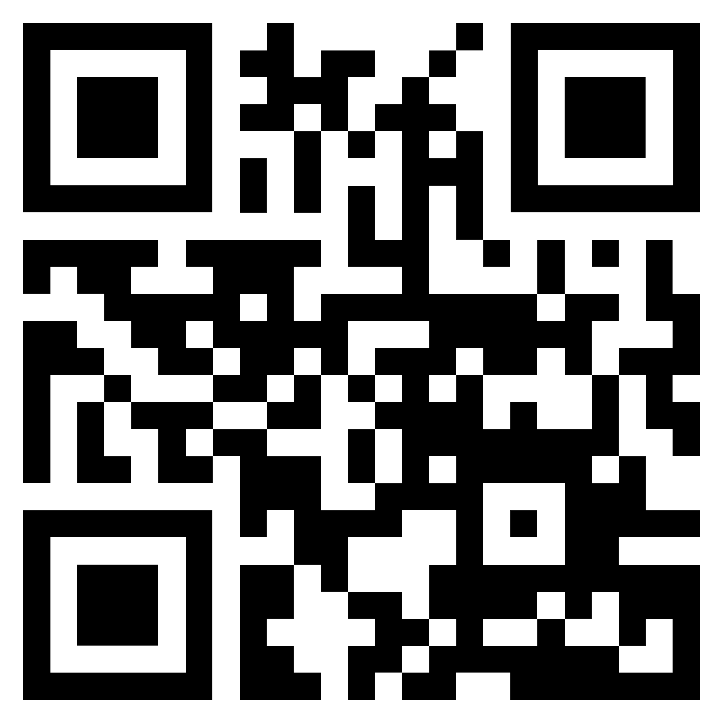
Improving onboarding with decentralized IDs Microsoft Entra Verified ID in entitlement management
Reduces need for self-attestation by new employees or business partners. Users requesting access will be able to obtain identity attributes from a wide set of issuers.
Scan the QR code below to submit your True ID credential.
Simplifies approval processes, as approvers do not need to personally vet requestor’s authenticity of claims
Simplifies compliance posture with increased consistency and reduced need for manual intervention

Slide 25
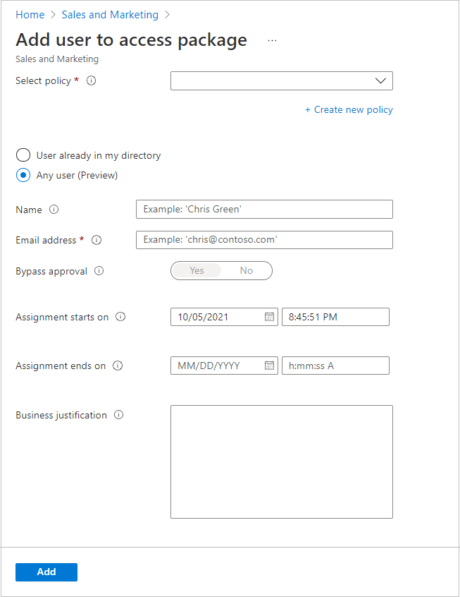
Directly assign any user (Preview)
Entitlement management also allows you to directly assign external users to an access package to make collaborating with partners easier. To do this, the access package must have a policy that allows users not yet in your directory to request access.

Slide 26
Features
Request Access for external users: When a user who isn't yet in your directory requests access, and is approved, they're automatically invited into your directory and assigned access.
Grant Access to Resources: Control who can get access to applications, groups, Teams and SharePoint sites, with multi-stage approval
Delegate external users administration: delegate to access package managers policies definitions with rules for which users can request, who must approve their access, and when access expires.
Verified ID: Require the users to present additional identity proofs during the request process such as a training certification, work authorization, or citizenship status.
Create external user during the Access Package assignment

Slide 27
Planning- Decisions to consider
-Define with which organization(s) you are going to collaborate with.
-Access Package name and description
-Approval levels does the access package will require
-Who will be able to request access?
-Approvers
-What information do the external users need to provide during the request?"
-Access Package expiration time
-Access Reviews requirements
-Verified ID Requirement

Slide 28
Deploy
Step | Instructions
1. Add connected organization in EM | Add connected organization
2. Enable Catalog for External Users | Settings for external users
3. Create an Access Package | Create an access package in entitlement management
4. Check the hidden setting on the access package | Change the Hidden setting
5. Required Verified IDs (Optional Step) | Create an access package with verified ID requirements
6. Onboard users from the access package assignment (Optional Step) | Directly assign any user (Preview)
7. Send a My Access portal link to the external organization contact | Share link to request an access package in entitlement management
Detailed Step by step
https://learn.microsoft.com/en-us/azure/active-directory/governance/entitlement-management-external-users#enable-catalog-for-external-users

Slide 29
Auto assignment Rules

Slide 30
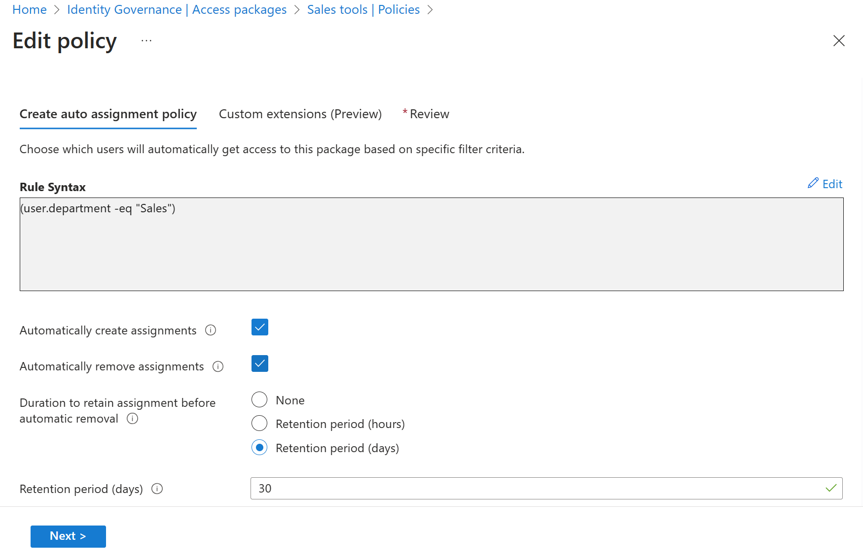
Assign and remove resources automatically Birthright assignment
Use rules to determine access package assignment based on user properties, similar to dynamic groups.
Assignments to users are added or removed depending on whether they meet the rule criteria.

Slide 31
Features
Automatically create assignments: Add the user when an user properties matches with the policy's membership rule
Automatically remove assignments : Remove the user when an user properties matches with the policy's membership rule

Slide 32
Planning- Decisions to consider
-Access Package name and description
-Define if this Access Package will have approval stages. If it does, define approvers and requestors.
-Attribute(s) for the Business rule definición
-Automatically create assignment
-Automatically remove assignment

Slide 33
Deploy
Step | Instructions
Create an Access Package | Create an access package in entitlement management
Create auto assignment policy | Create an automatic assignment policy
Detailed Step by step
Configure an automatic assignment policy for an access package in entitlement management - Microsoft Entra | Microsoft Learn

Slide 34
Custom Workflows with Logic Apps

Slide 35
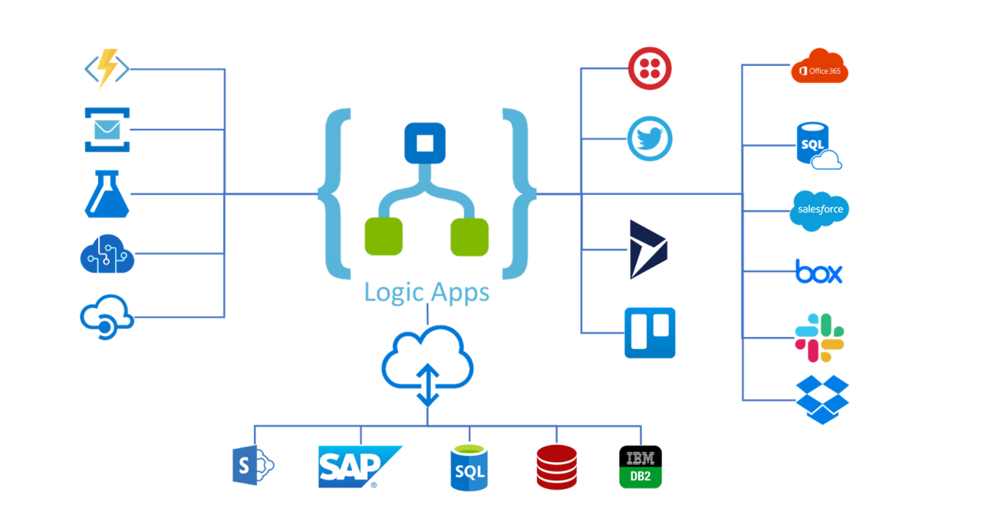
What is a Logic App?
Azure Logic Apps is a cloud platform where you can create and run automated workflows with little to no code. By using the visual designer and selecting from prebuilt operations, you can quickly build a workflow that integrates and manages your apps, data, services, and systems.

Slide 36
Logic App Integration with Entitlement Management
Used to automate custom workflows and connect apps and services in one place. Users can integrate Logic Apps with entitlement management to broaden their governance workflows beyond the core entitlement management use cases.
When an access package request is created
When an access package request is approved
When an access package assignment is granted
When an access package assignment is removed
14 days before an access package assignment auto expires
One day before an access package assignment auto expires

Slide 37
Use cases examples
Send custom email Notifications
Send Teams notification
Get user information from other applications
Writeback user information to external systems
Call an External web api to trigger actions on external systems
Creating a set of tasks in Microsoft planner
Generate a TAP

Slide 38
Planning- Decisions to consider
Processes that you need to automate during the different request stages
Interfaces available on Target systems
Request stage where you want to trigger the logic app
Have Azure Subscription Resources available
Logic App authentication with target systems

Slide 39
Deploy
Step | Instructions
1. Add custom Extension to a Catalog | Create and add a Logic App workflow to a catalog for use in entitlement management
2. Edit the Custom Extension | Edit a linked Logic App's workflow definition
3. Add custom Extension to an Access Package | Add custom extension to a policy in an access package
Detailed Step by step
Trigger Logic Apps with custom extensions in entitlement management - Microsoft Entra | Microsoft Learn

Slide 40
Convert existing external users to be governed

Slide 41
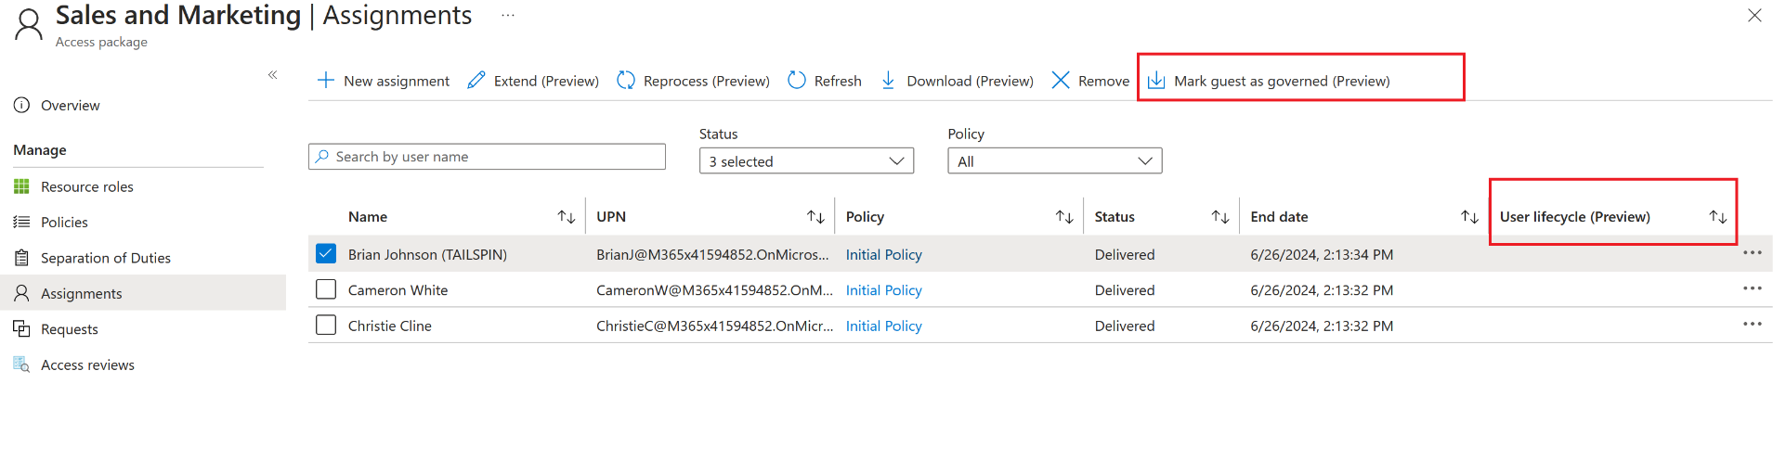
External User states
Entitlement management allows you to gain visibility into the state of a guest user's lifecycle through the following viewpoints:
Governed - The guest user is set to be governed.
Ungoverned - The guest user is set to not be governed.
Blank - The lifecycle for the guest user isn't determined. This happens when the guest user had an access package assigned before managing user lifecycle was possible.

Slide 42
Planning- Decisions to consider
Create a new access Package or use an existing one
How assign the existing external users to the access package?
Auto Assignment Policy – Define a Rule
Self Request – Define approvers and approval levels
Direct Assignment

Slide 43
Deploy
Step | Instructions
1. Create and Access Package (optional) | Create an access package in entitlement management
2. Add Auto Assignment Policy (optional) | Create an automatic assignment policy
3. Convert users to governed | Manage guest user lifecycle in the Azure portal

Slide 44



Scenario: Access Recertification
Joiner / Mover / Leaver
Microsoft Entra ID P2
Access Reviews - Basic access certifications and reviews
Microsoft Entra ID Governance:
Access Reviews targeting inactive identities
Certify PIM for Groups memberships
Machine Learning assisted recommendations
Access Lifecycle Management
Access Recertification
Identity
Secure privileged access for administration

Slide 45

Access recertification to reduce risk Access Reviews
Natively built-in to Microsoft Entra
Manage risk and meet compliance for users, guests and workload identities
Ensure access to sensitive Teams, Groups, Apps, Roles is reviewed periodically

Slide 46
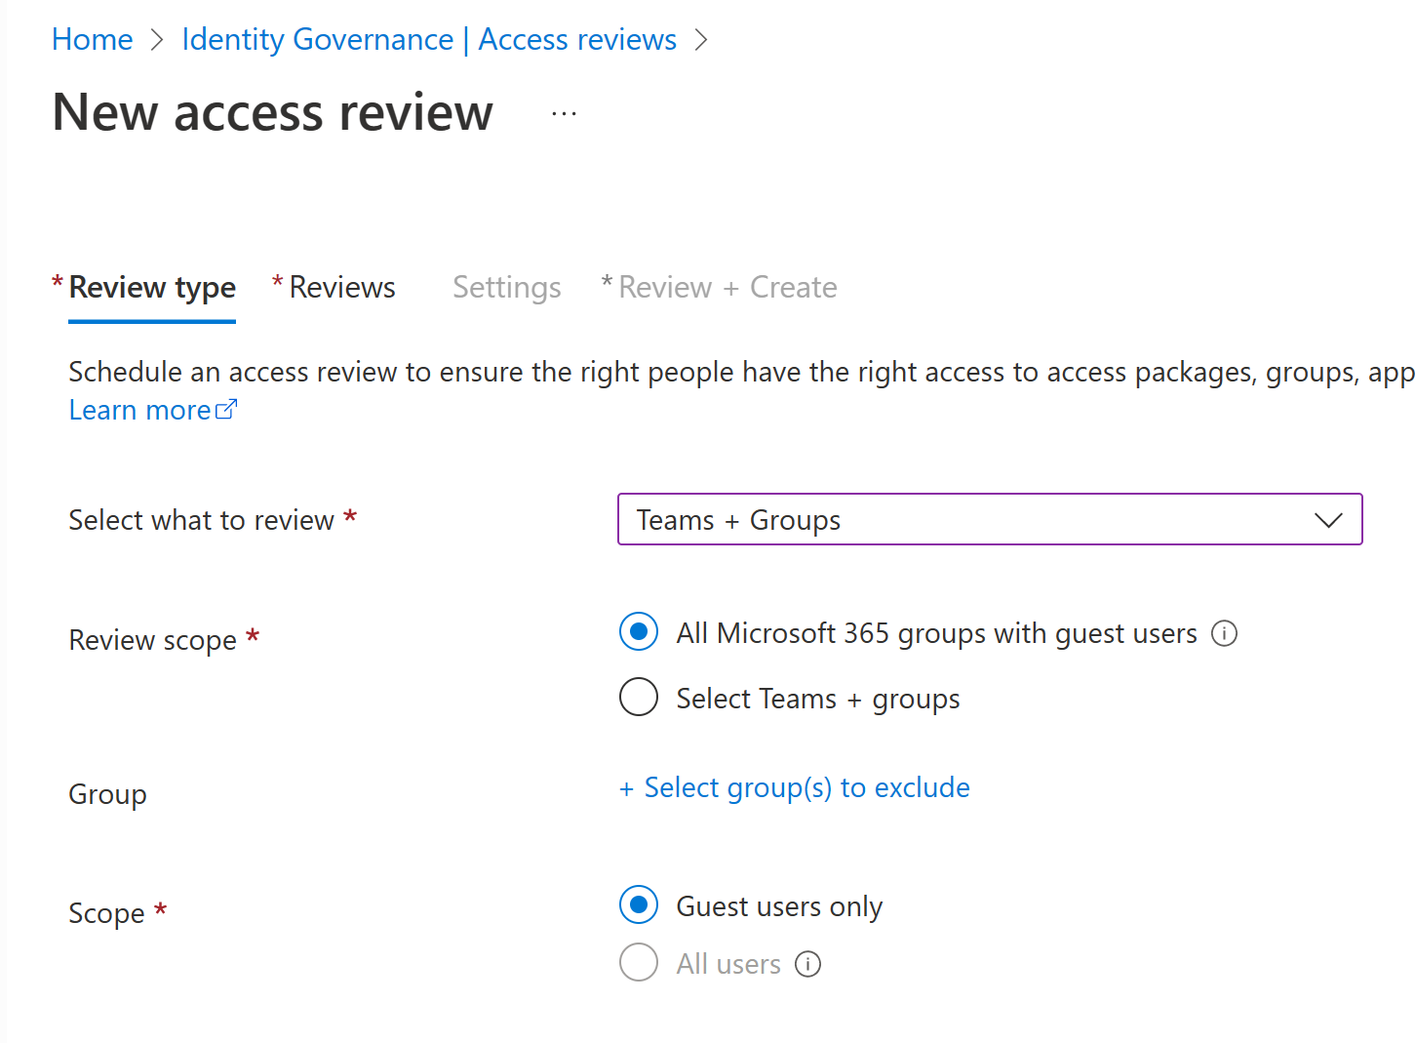
How Access Reviews works Administrator
1. Selects resource
2. Selects scope
Team/Group
SaaS application
Privileged role
Access Package
Guests
Employees
Everyone
Workload Identities
3. Selects reviewer
4. Selects frequency
Team/Group owner
Manager
Specific user(s)
Users’ self review
Weekly
Monthly
Quarterly
Yearly

Slide 47
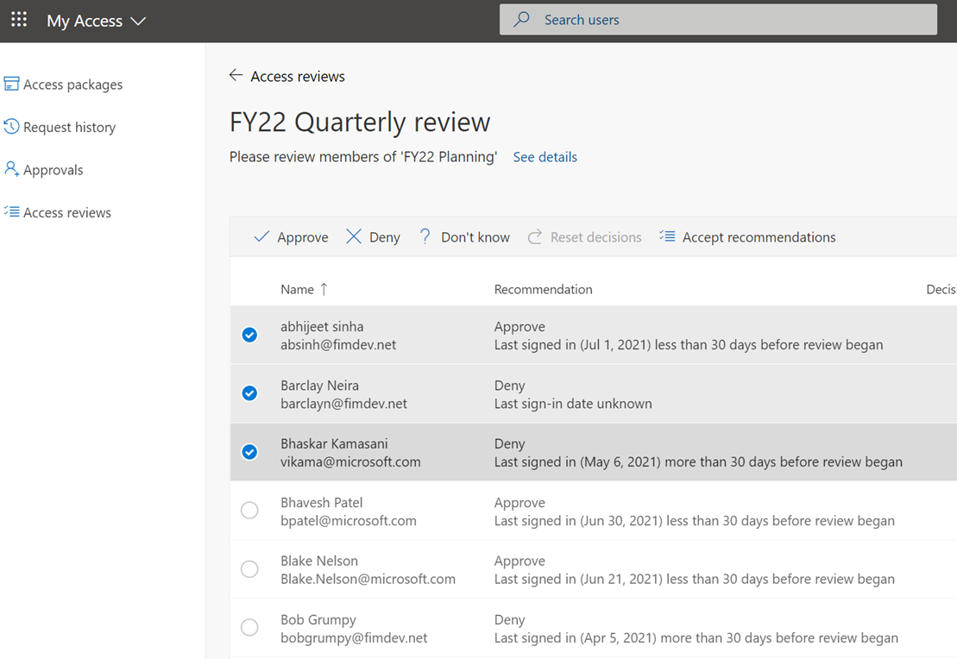
How Access Reviews works Reviewer
1. Send notification
2. Review
Email is sent to the reviewer
Review current membership with system generated recommendations
3. Confirm
4. Apply result
Reviewers confirm which memberships to keep
Denied users are removed from the resource

Slide 48


Access Reviews Scenarios
Employees | External Users
Change jobs or leave the company Employee's previous access are not removed. Users accumulate excessive permissions | Guests invited into the tenant What access should they have? When should they leave?
B2B
Notes:
Employees:
Forget to remove employee's previous access rights.
Users accumulate excessive permissions, increasing risk and the likelihood of audit findings.
Make sure you exclusion groups in CA are always reviewed: https://docs.microsoft.com/en-us/azure/active-directory/governance/conditional-access-exclusion

Slide 49
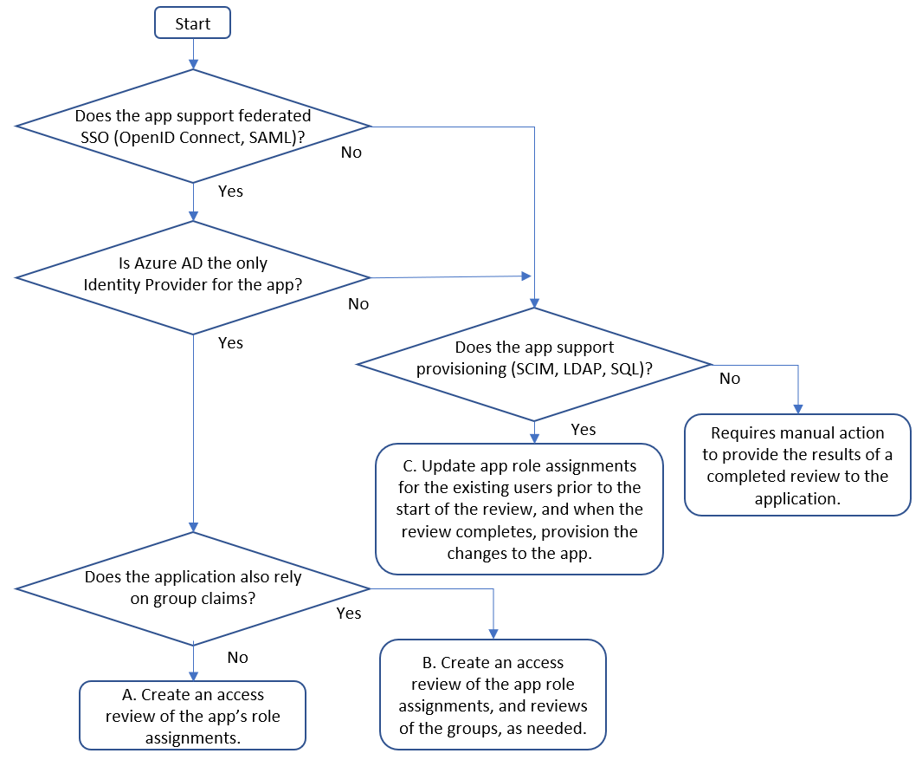
Planning
Determine application readiness

Slide 50
Planning- Decisions to consider
1. Who is responsible for the review?
A. Users review their own privilege​
Schedule access review to ask users themselves if they still need access.
Remove privilege if the user denies or does not respond.​
​B. Resource owners review privileges assigned to their resources.​
Schedule access review to ask resource owners to review the privileges assigned to their resource.
Possible Reviewers:
Group Owners
Specific Users
Managers of Users

Slide 51
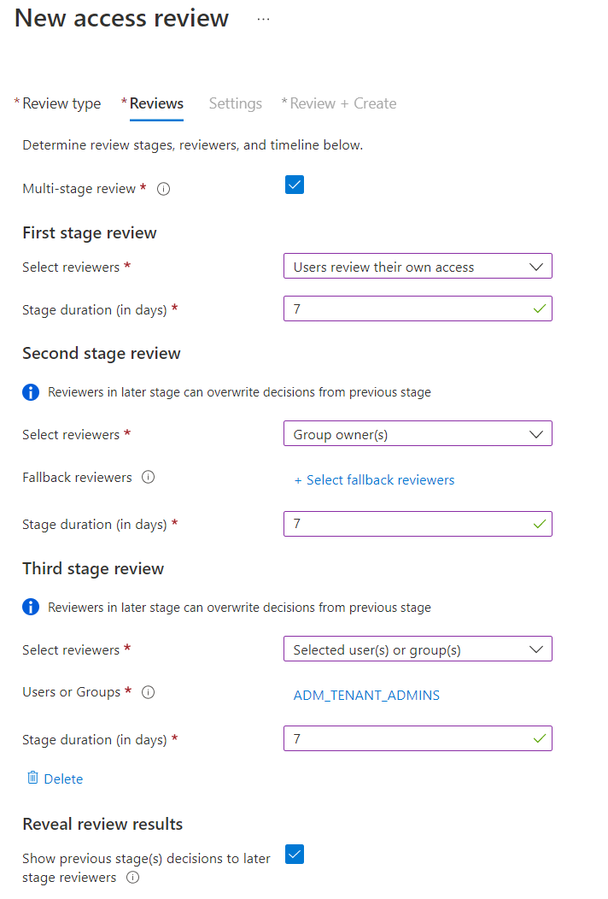
Planning (Contd)
2. How many stages of reviews are needed?
Reach consensus across multiple sets of reviewers
Assign alternate reviewers to weigh in on unreviewed decisions
Reduce burden on later stage reviewers

Slide 52
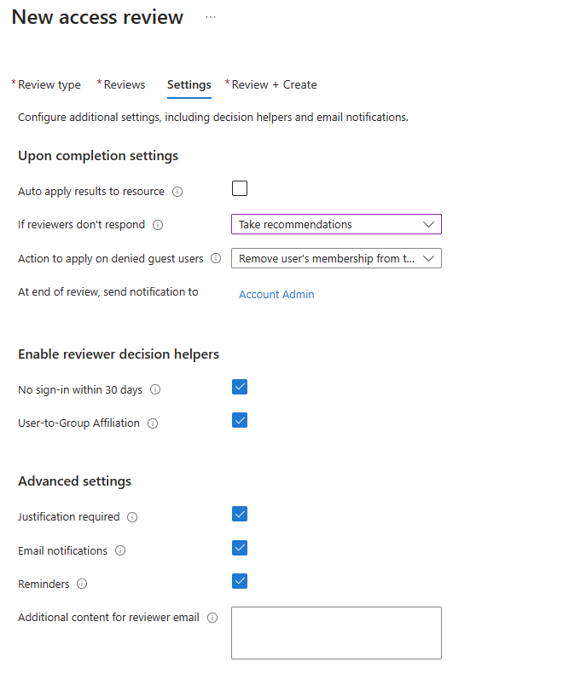
Planning (Contd)
3. Decide on criteria for automated decisions
Response Triggers
Account Inactivity
Justification requirements
Alerting and notifications

Slide 53


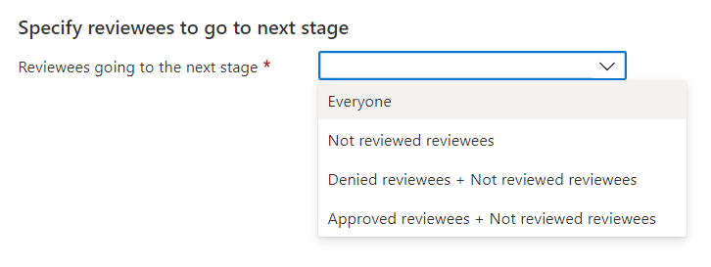
Multi-stage Access Reviews Meet complex audit and recertification requirements through multiple stages of reviews
Reach consensus across multiple sets of reviewers. Requires agreement from independent reviewers at every stage before access is recertified.
Assign alternate reviewers to weigh in on unreviewed decisions. Ensure accounts left unreviewed by unresponsive or out-of-office reviewers are sent to the next appropriate reviewer, such as the user’s manager or the resource owner.
Reduce burden on later-stage reviewers. Filter down the number of decisions for your later-stage reviewers by excluding accounts denied in previous stages. For example, have users attest to their own needs for access before asking the resource owners to attest.
Review phase
Apply results
Review ends
Stage 1 reviewers attest
Stage 2 reviewers attest
Stage 3 reviewers attest
Stage 1 ends
Stage 2 ends
Stage 3 ends

Slide 54
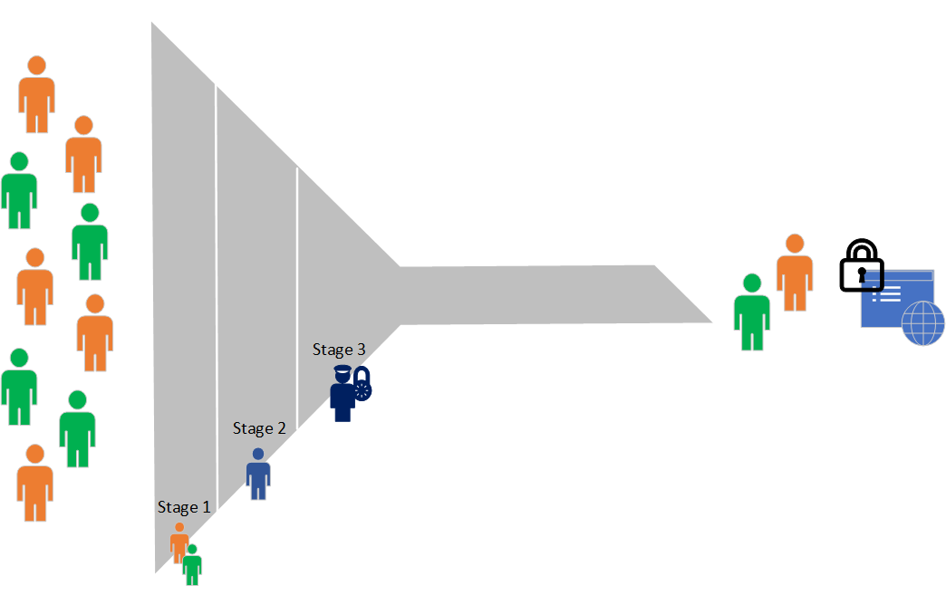
Multi-Stage Reviews Decisions
First stage reviewers?
Select user(s) or group(s) – the owner(s) of the applications
Second stage reviewers?
Managers of users
Show previous stage(s) decisions to later stage reviewers?
Which reviewees go to the next stage?
Expected action on non-response?
Approve/Deny

Slide 55
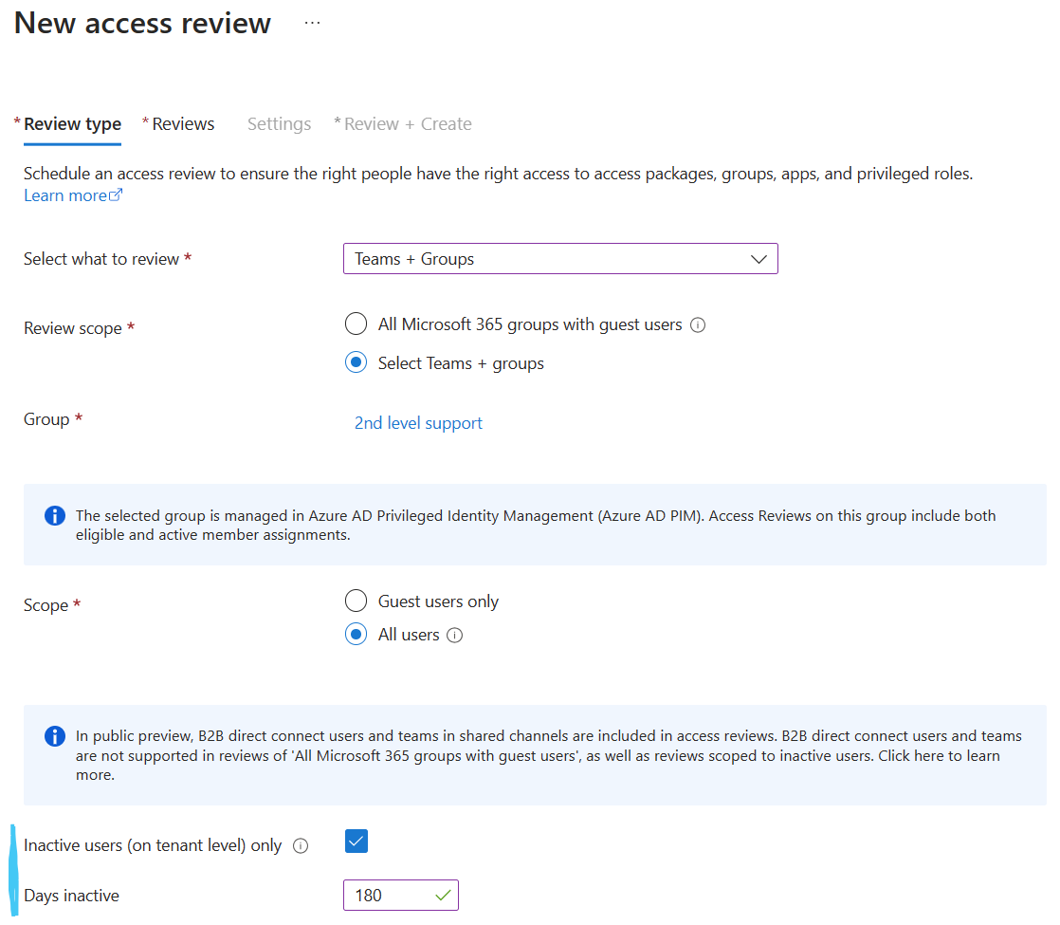
AR – Inactive Users General Availability
Review inactive users
Review and address stale accounts that haven’t been active for a specified period
Includes interactive and non-interactive sign-ins
You define what inactive means
Automatically remove stale accounts
Notes:
Source: Review inactive user accounts

Slide 56




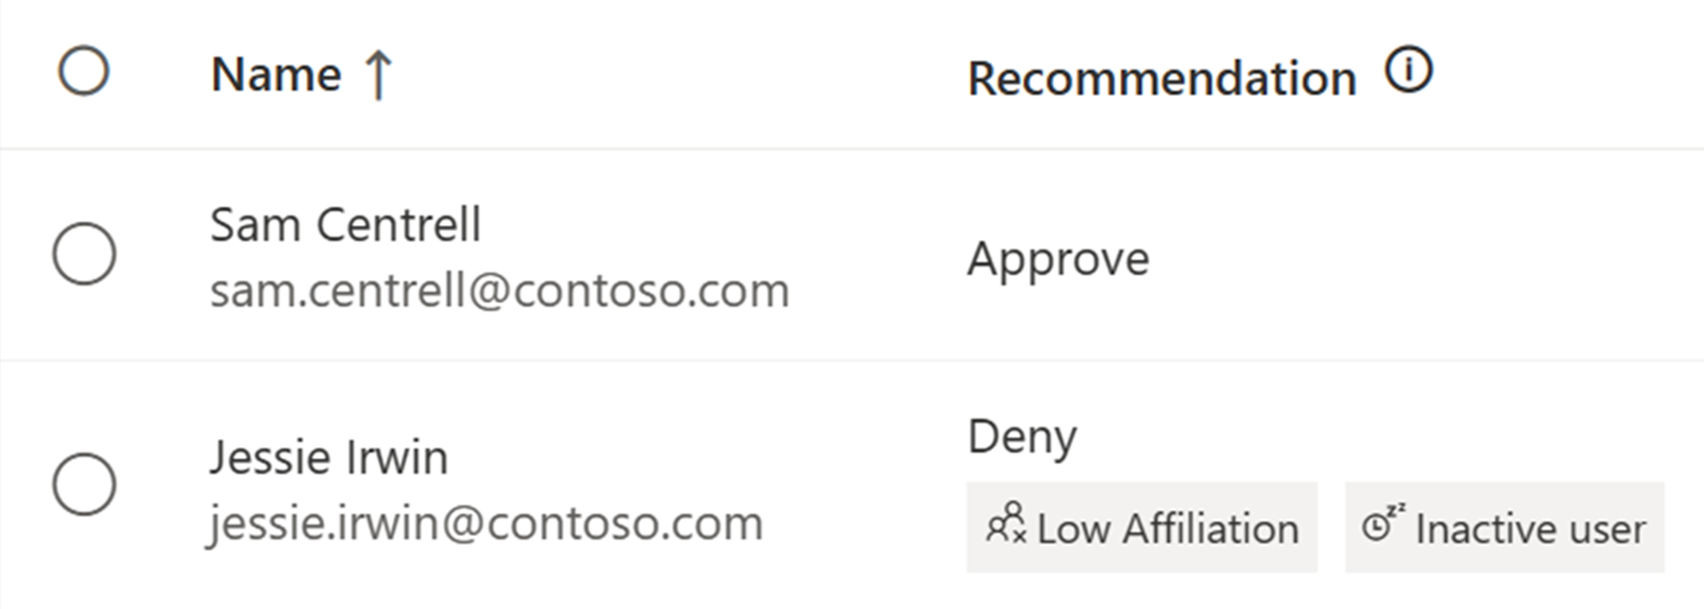



Machine Learning based recommendations in Access Reviews User-to-Group Affiliation
Machine Learning uses organizational distance to calculate group affiliation
Reviewers get data driven recommendations based on last sign in date and group affiliation
Admins create Access Review to protect against breaches and stay compliant
Last sign in activity
Sam Centrell
18 days
Jessie Irwin
125 days
Inactive user recommendation considers activity based on last sign in date
Demo: User-to-Group Affiliation
Notes:
Reviewers see the recommendation if a user has Low Affiliation with other users within the group and helps make quicker decisions based on organizational distance between employees.

Slide 57
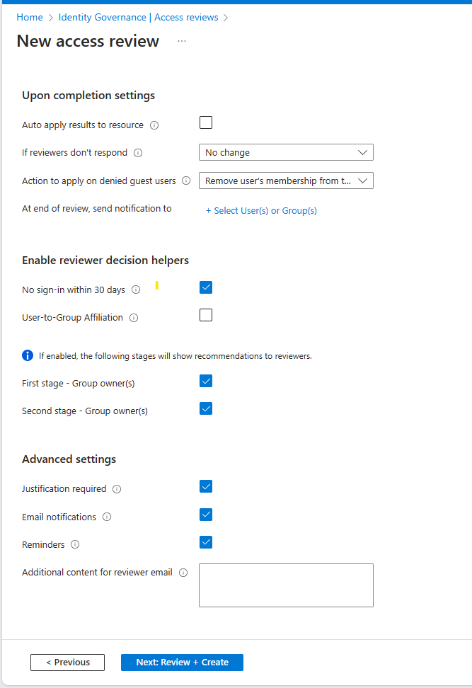
User to Group Affiliation
Detects user affiliation with other users within the group, based on organization's reporting-structure similarity.
Users who are distant from all the other group members based on their organization's chart, are considered to have "low affiliation" within the group.
** Only available for users in your directory.
** A user should have a manager attribute
**Groups with more than 600 users are not supported.
Demo

Slide 58
Access Reviews for Guests

Slide 59


Reduce risk of guest users in Teams and Microsoft 365 groups
2. Guests are added to the team
3. Access reviews detects teams with guests and triggers review on them
1. Creates a team
Newly created groups that have guests, and existing groups that have newly added guests are automatically included in the review
Designate group owners or guests themselves to be the reviewer
Ensure that guest users retain only the access they need to Teams and Microsoft 365 groups
5. (Optional) Denied guests are blocked from signing in and then deleted
4. Membership reviewed; System provides recommendations based on last sign-in

Slide 60
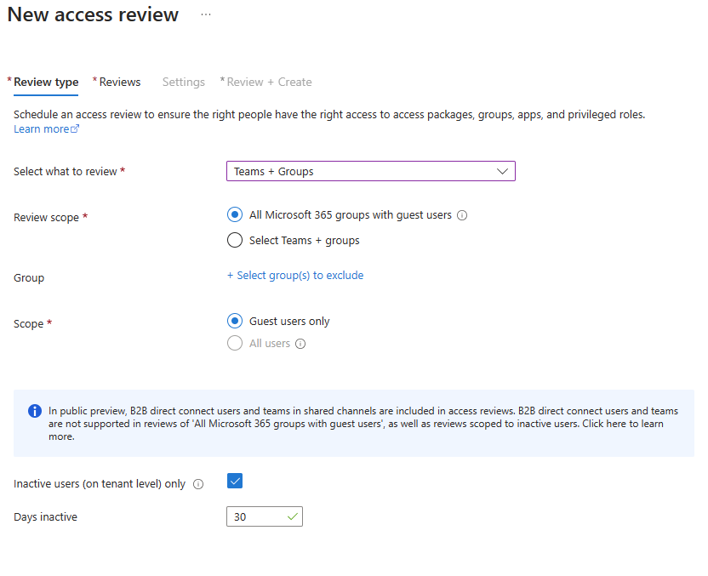
Access Certification for Guests
You can review either:
A group in Microsoft Entra ID that has one or more guests as members.
An application connected to Microsoft Entra ID that has one or more guest users assigned to it.
A guest is “inactive” if a sign in event isn’t recorded in 30 days

Slide 61
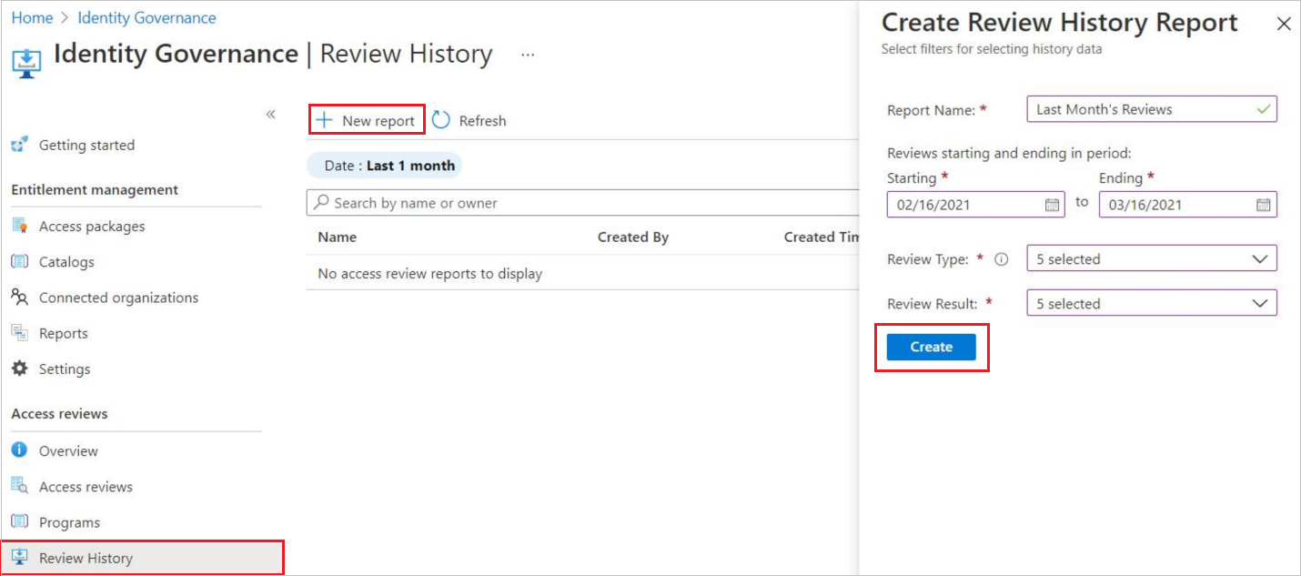
Access Review history report
Downloadable review history to gain more insight on Access Reviews.
Download results for audit and compliance needs, or to integrate with other solutions.
Reports can be constructed to include specific access reviews, for a specific time frame, and can be filtered to include different review types and review result.

Slide 62
Deploying Access Reviews Guide
Scenario | Instructions
Planning an Access Reviews Deployment | Plan a Microsoft Entra access reviews deployment
Access review of PIM for Groups | Create an access review of PIM for Groups (preview)
Access review of Azure resource and Microsoft Entra ID roles in PIM | Complete an access review of Azure resource and Microsoft Entra ID roles in PIM
Access review of an access package | Create an access review of an access package in entitlement management

Slide 63
Logic App Example (optional)

Slide 64
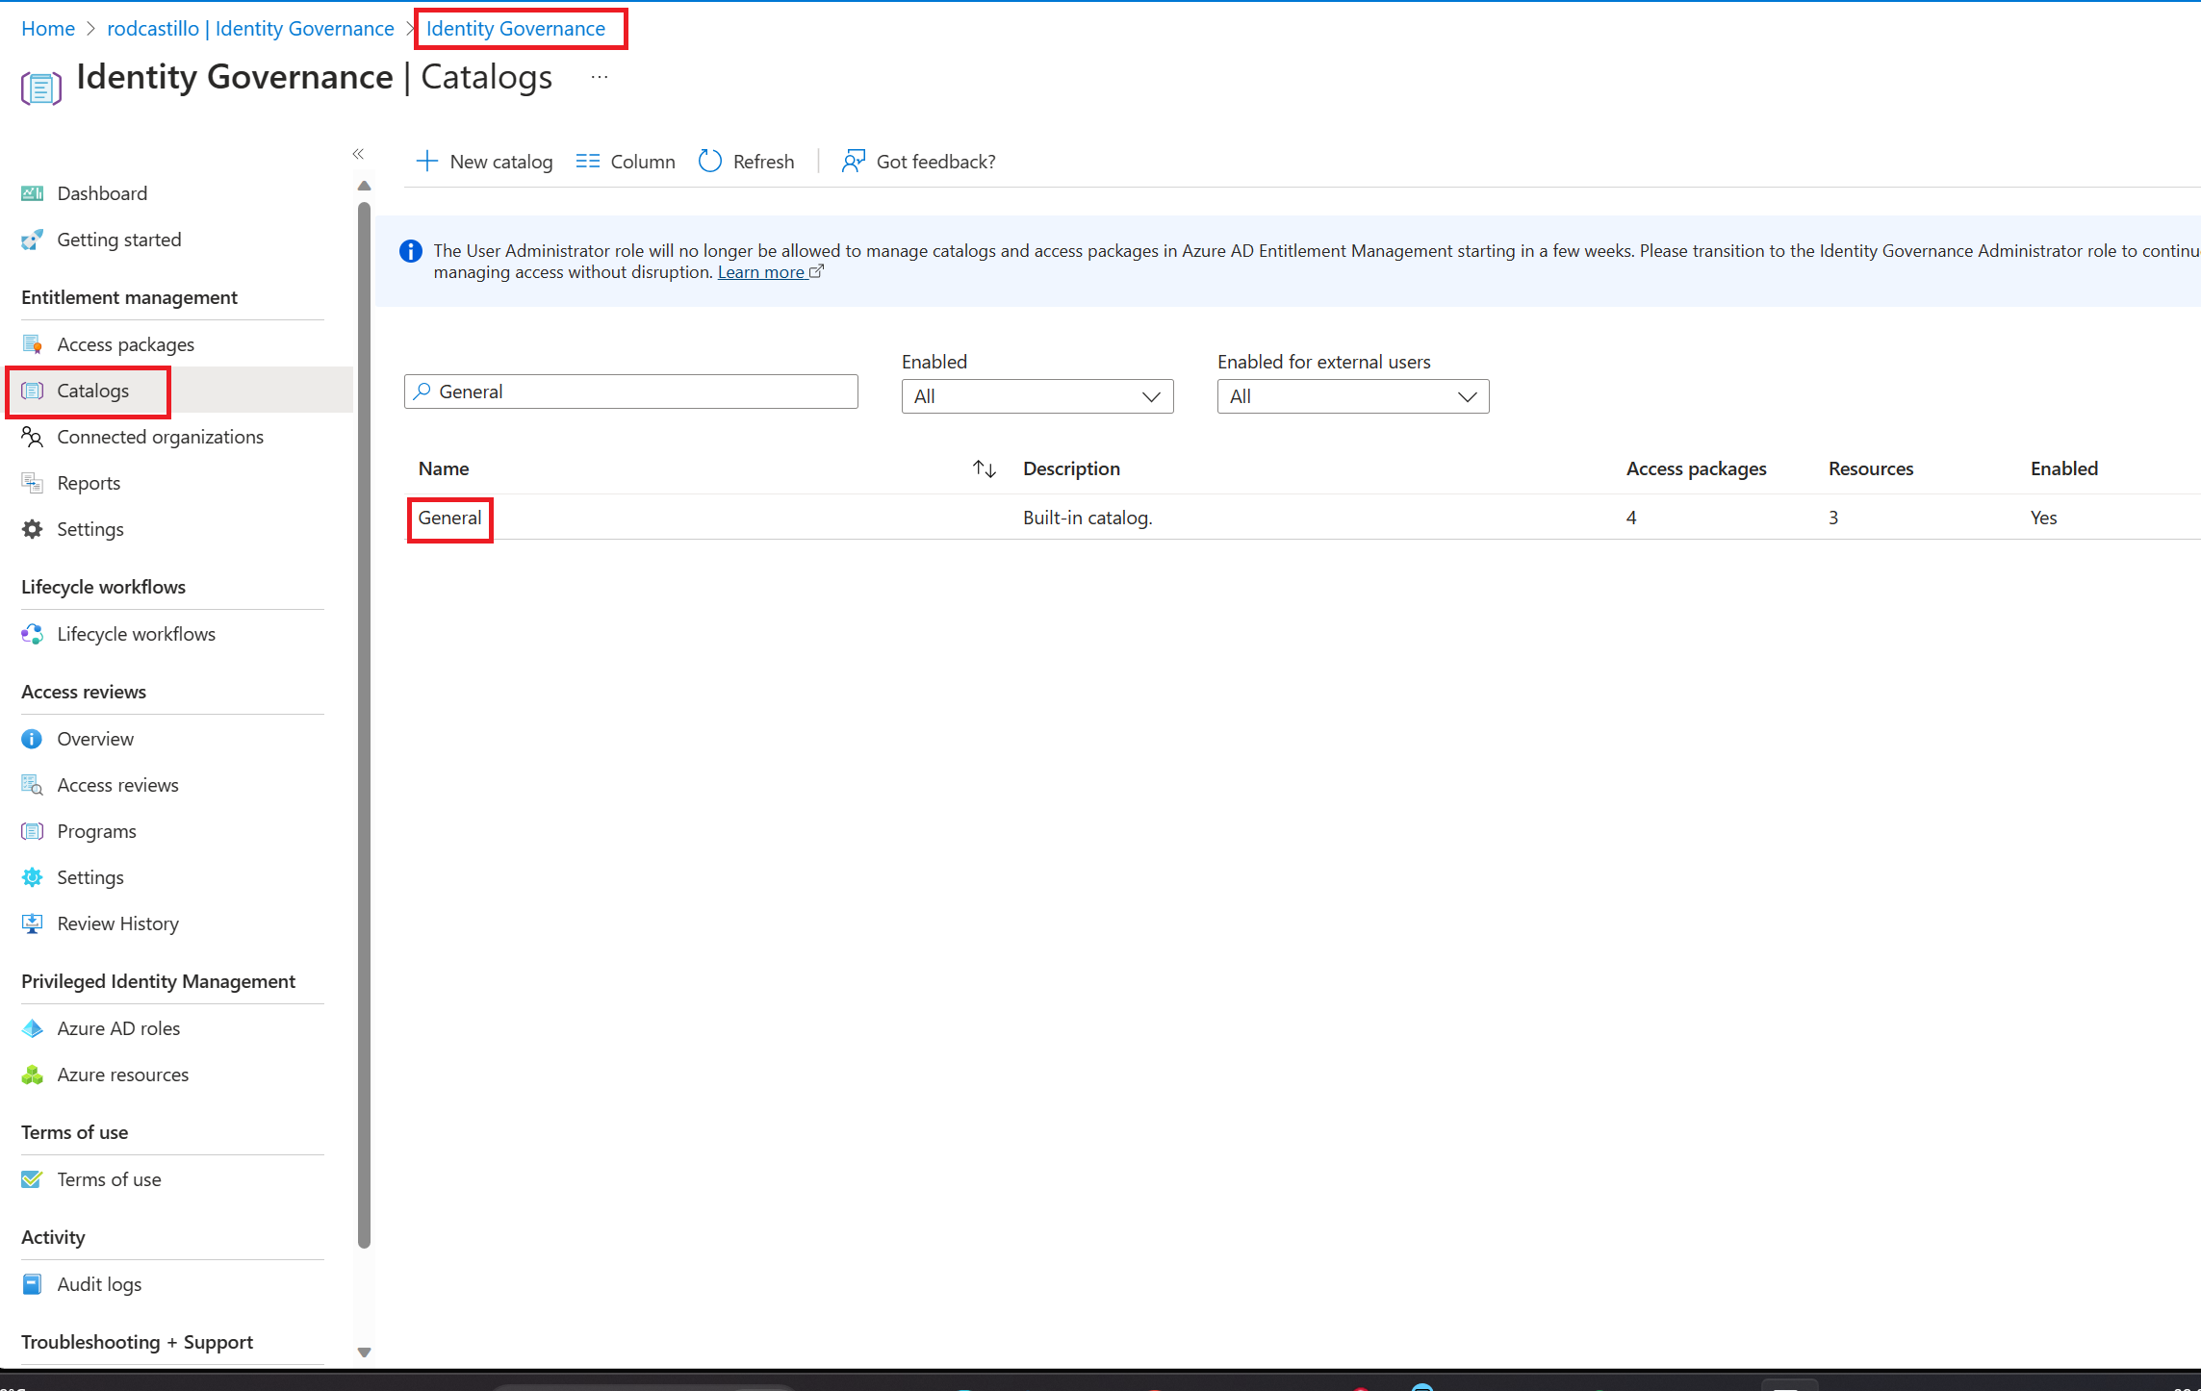
Step 1 Create Logic App
On the Azure portal, go to Azure Active Directory
On the left menu, select Identity Governance.
On the left menu, select Catalogs
On the Catalogs Blade open the General Catalog

Slide 65
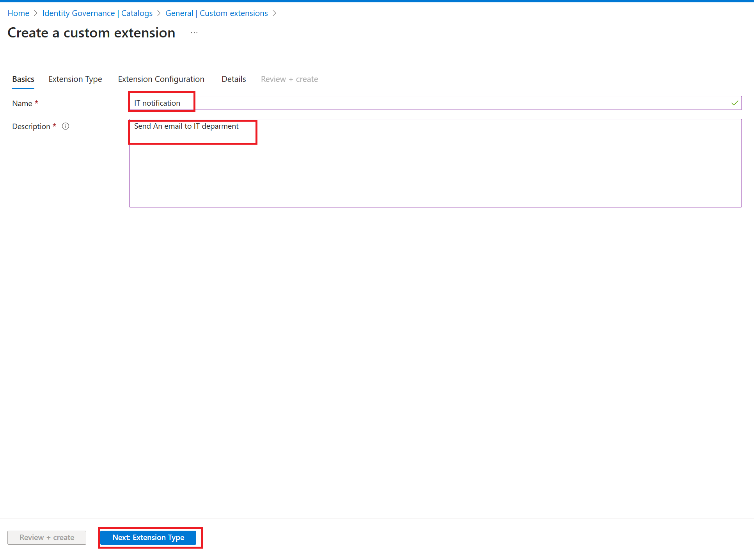
Step 1 Create Logic App
On the General Catalog blade, select Custom Extensions on the left menu
On the Custom Extensions blade, select Add Custom extension.
Write IT Notification as Name and Send an email to IT department and Click on Next

Slide 66
Step 1 Create Logic App
On Extension Type Tab, select Next
On the Extension Configuration, select Next
On the Details tab, Select your Subscription, resource group and write SentITNotification as Logic app name
Select Create Logic App
After the logic app was created, select Review + Create and then Create

Slide 67
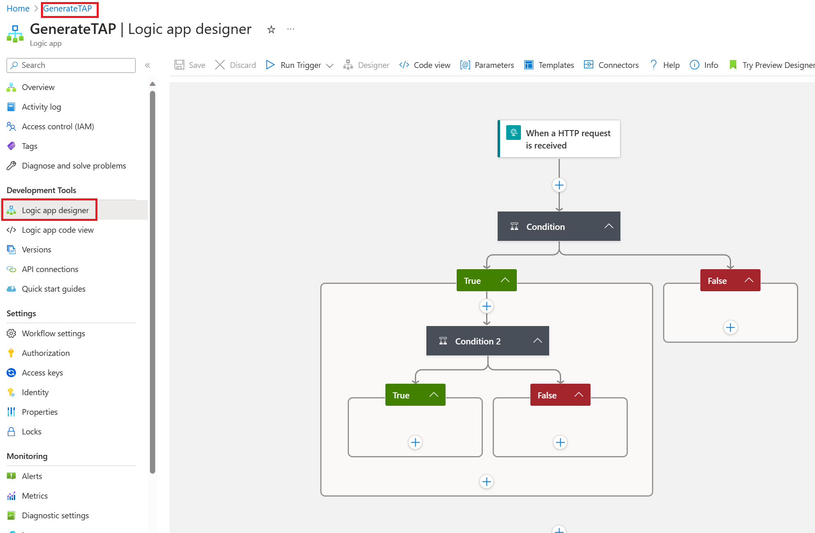
Step 2 Customize Logic App
On The Azure Portal, go to Logic Apps
Open SendITNotification
On the Left Menu, select Logic App designer

Slide 68
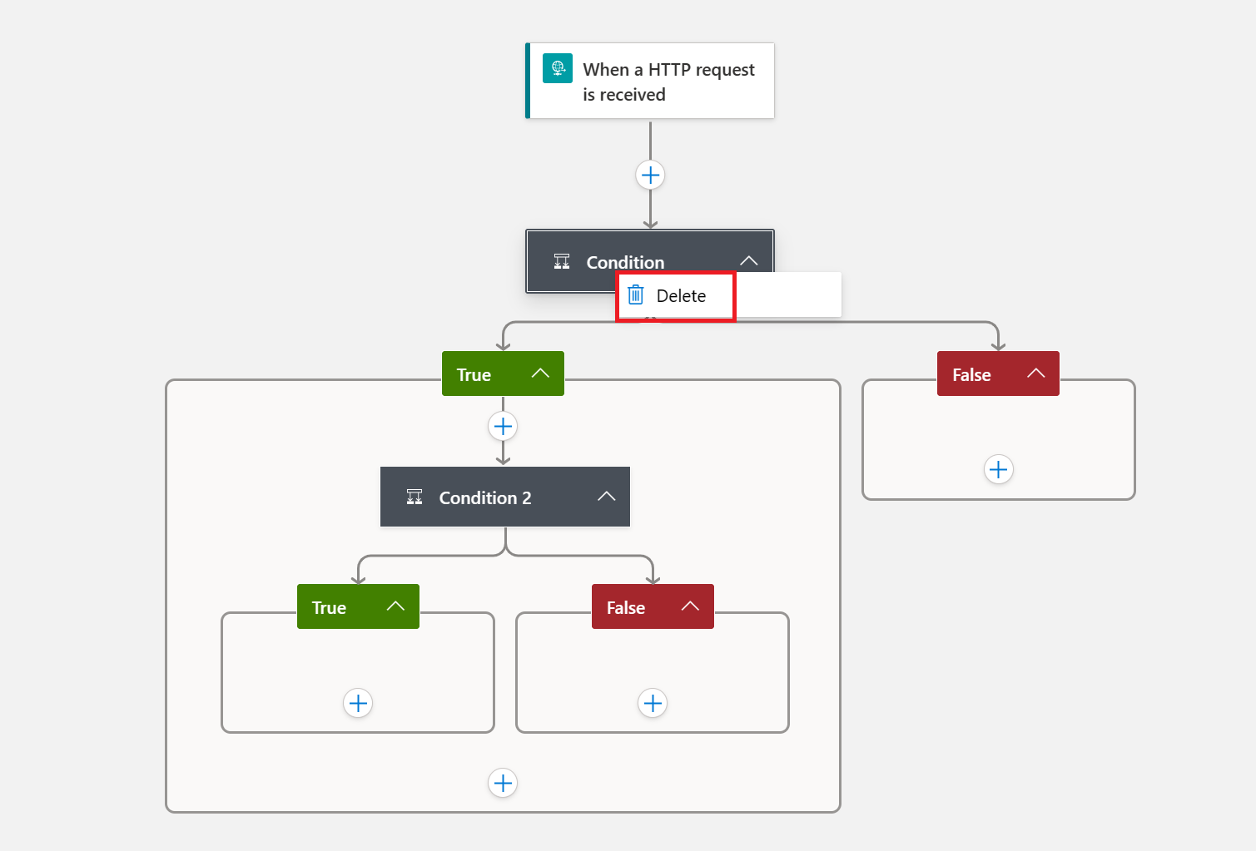
Step 2 Customize Logic App
On the Condition, right click and select delete
After it, only one activity should appear on the Workflow designer

Slide 69
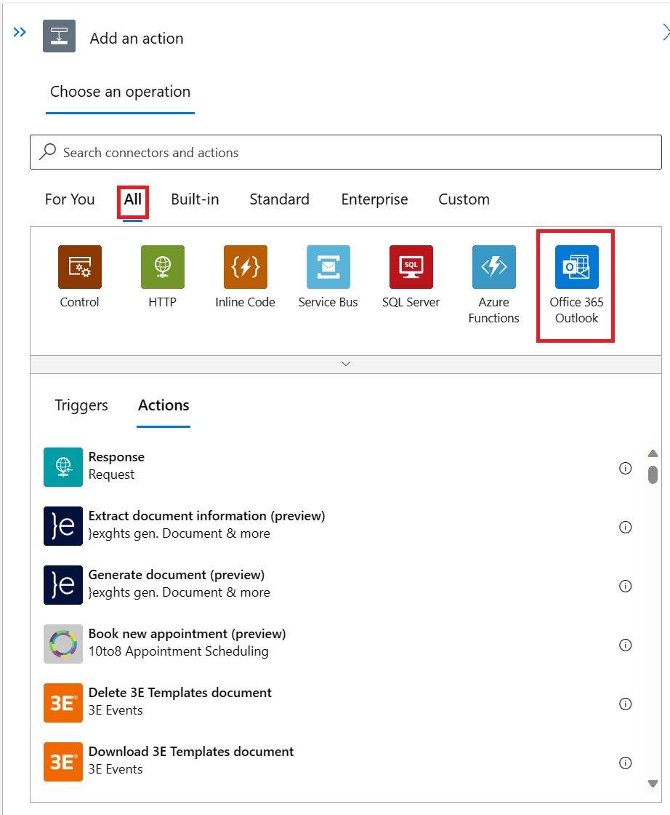

Step 2 Customize Logic App
On the Workflow designer, click on the plus symbol ( )
Select Add an Action
On the Add an Action blade, go to All tab and select Office 365

Slide 70
Step 2 Customize Logic App
On the Actions tab, select Send Email (v2)

Slide 71
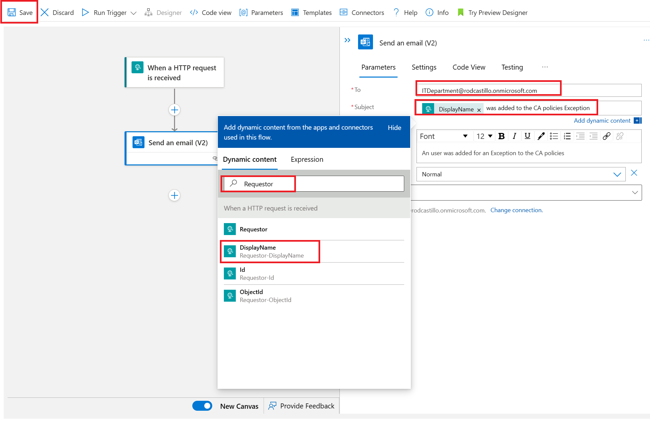
Step 2 Customize Logic App
On send an email Action (v2), write the name of your IT DL as To
Select the subject textbox, clic on the Add dynamic content link, on the add dynamic content window search for Requestor and Select DisplayName
Write An user was added for an Exception to the CA policies as body
Select Save

Slide 72
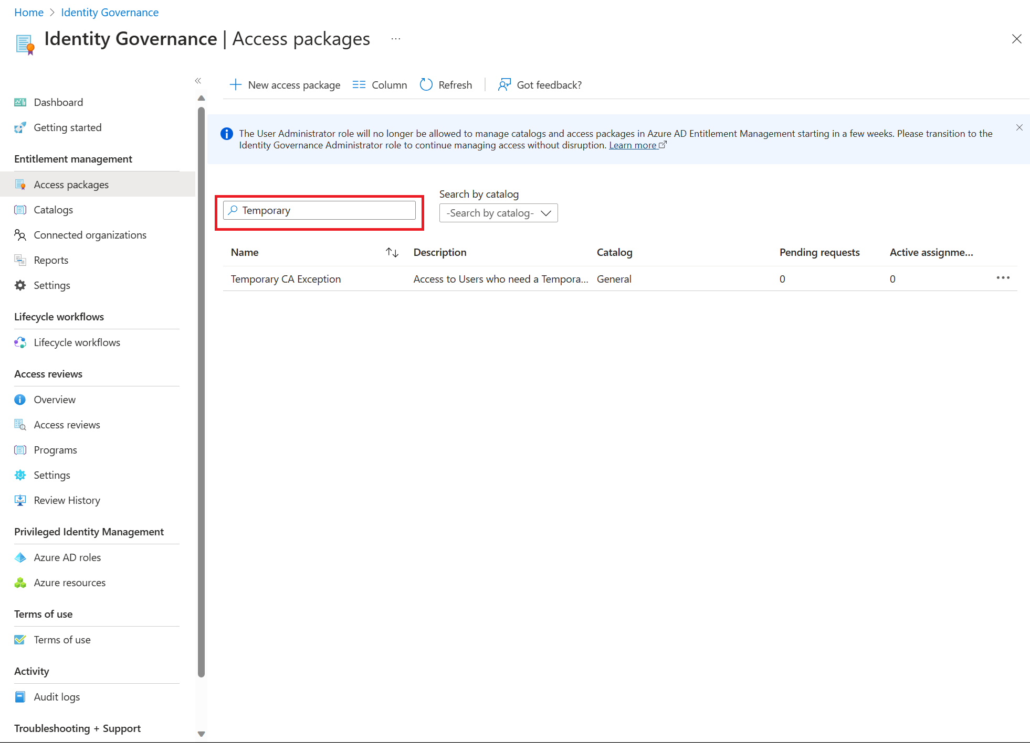
Step 3: Search the existing Access Package
On the Entra portal, in the left navigation, under Identity Governance select Entitlement Management
On the left menu, select Access packages.
On the search bar, write temporary and press Enter to get the access package created on the past scenario
Open it

Slide 73
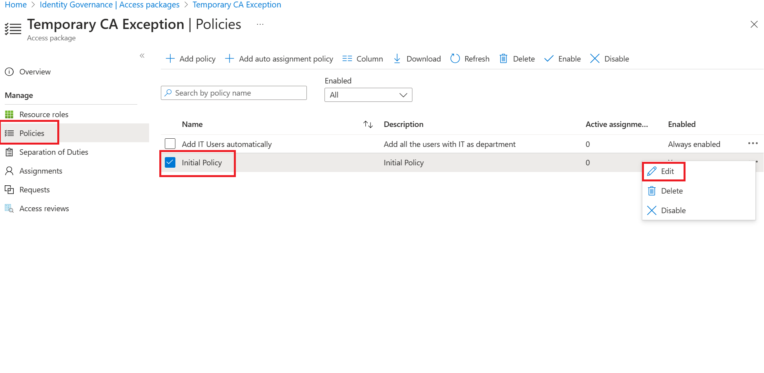
Step 4 Trigger Logic App from the Access Package
Select Policies on the left menu
Select Initial Policy
Select the 3 points and select Edit

Slide 74
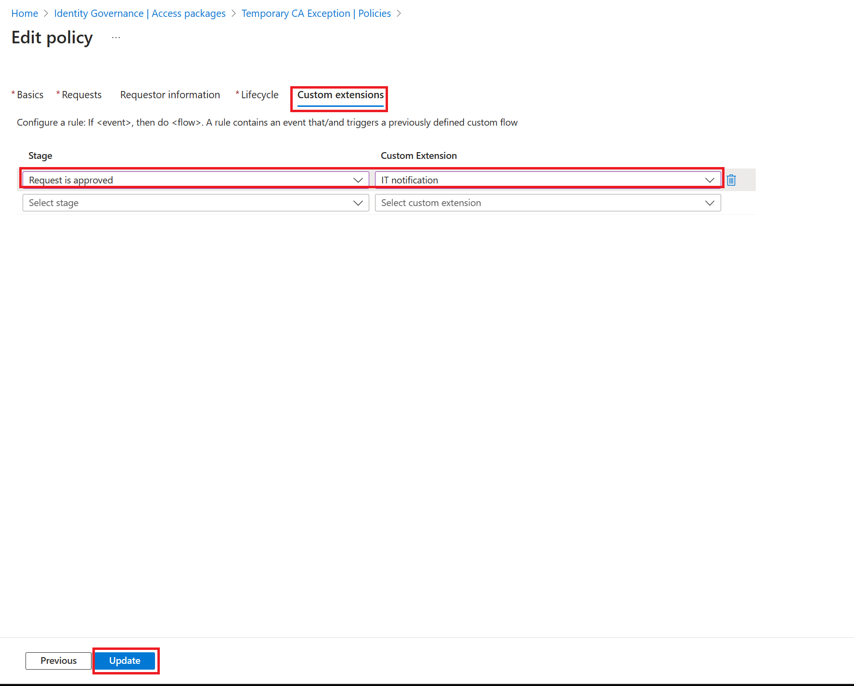
Step 4 Trigger Logic App from the Access Package
Go to Custom Extensions tab
Select Request is approved as stage ok
Select IT notification as Custom Extension
Select Update

